Slide 1
Object oriented Analysis &Design
面向对象分析与设计
Lecture_04 Domain Model
Presented by: Xiaohong Chen
2020/9/29

Slide 2
Outline
Domain models（领域模型）
  Identify conceptual classes related to the current iteration.
  Create an initial domain model.
  Model appropriate attributes and associations.
  How to get a good quality domain model?

Slide 3
要求掌握的内容
如何写好一领域模型？
  掌握Guidelines
  掌握两个案例的领域模型

Slide 4
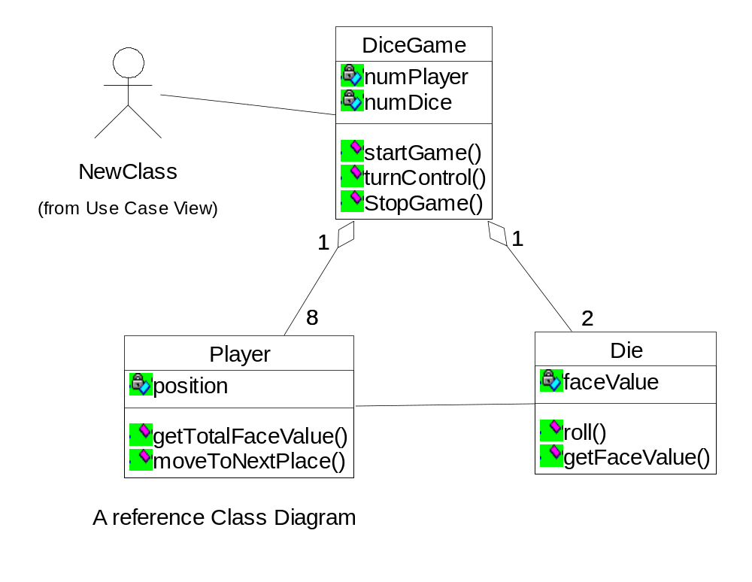
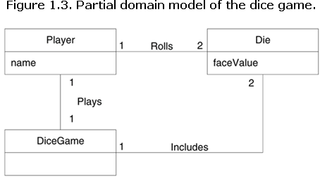
Review: Ch9. Domain Model
What is a Domain Model?
  A conceptual model， a representation of concepts in a problem domain.
How to visually represent ‘Conceptual class” in UML?
  In UML it is basically a “class diagram without operations”.
  It may show:
    Concepts
    Associations of concepts
    Attributes of concepts
Notes:
领域模型可以作为设计某些软件对象的灵感来源。

Slide 5
待思考问题列表
领域模型是否等于设计模型？
如果不等于，领域模型与设计模型之间的关系？
领域模型与数据模型的区别？

Slide 6
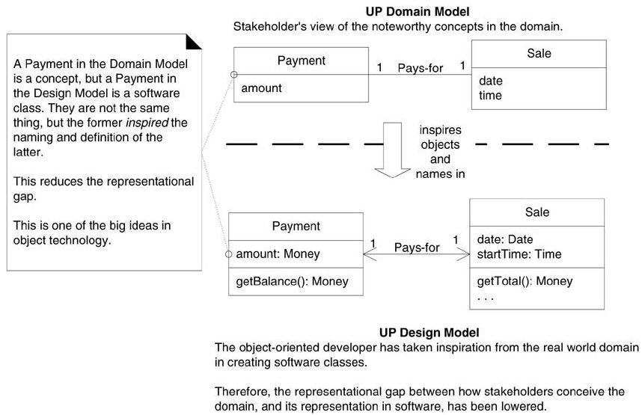
Domain Model vs. Design Model
Same names and notation lower the representation gap

Slide 7
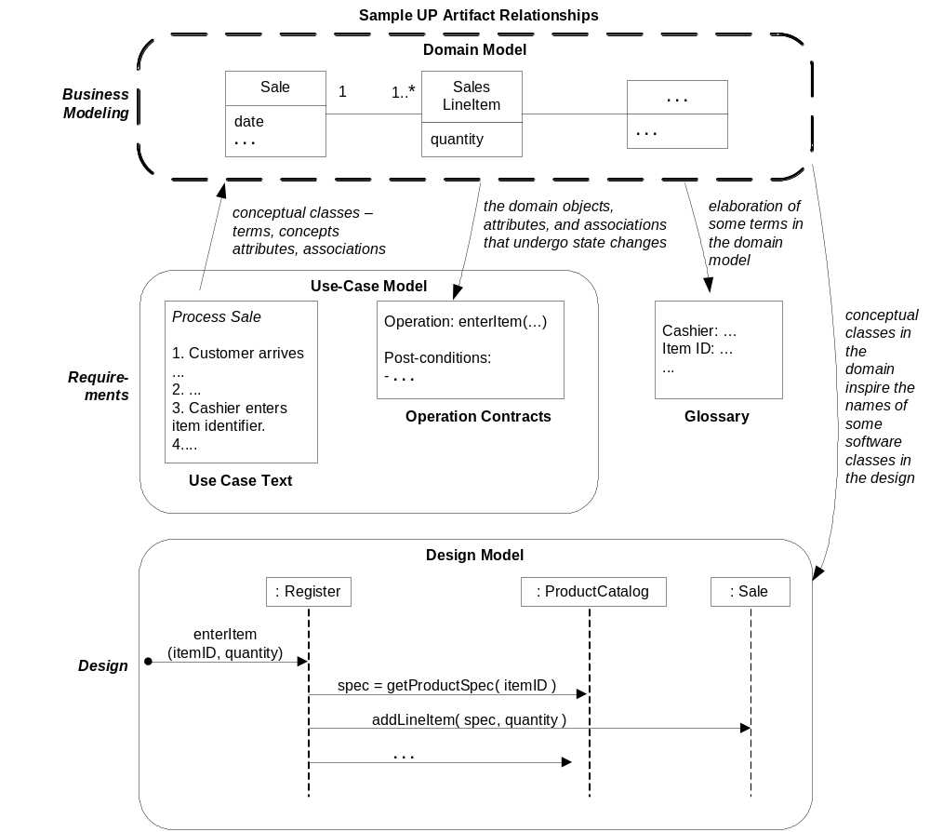
Why domain Model?
领域模型又会影响操作契约、词汇表和设计模型，尤其是对软件对象
Use case,expert’s opinions are the input of creating domain model 用例概念、专家观点是创建领域模型的输入
Domain model can inspire some software design.领域模型可以作为设计某些软件对象的灵感来源
LRG：Low Representation Gap 减少与OO建模之间的表示差异
Figure 9.1. Sample UP artifact influence
Notes:
Ch 9.3

Slide 8
Review: Domain Model: how to create?
Find conceptual classes
Add associations
Add attributes
What is concept class?
  an idea, thing, or object in the problem domain
how to Identify Concepts
  Reuse or modify existing models.
    This is the first, best, and usually easiest approach, and where I will start if I can.
  Finding Concepts with the Concept Category List.
  Finding Concepts with Noun Phrase Identification.
  CRC? // stereotype of class [boundary/entity/control]
Notes:
Ch 9.4 Refine existing model and/or use patterns
Explore concepts in the Category List
See Table 9.1
Explore Noun Phrases
Lexical/linguistic analysis of use cases and other text documents
See page 142

Slide 9
Domain Model vs. Data Model?
Domain Model
  Concepts, entities, can be abstract
  Relations
  Attributes
Data Model
  How data is stored into persistent storage
  Pure data, in files or databases
Notes:
Ch 9.2

Slide 10


Guideline （ch9.7~9.13）
Agile Modeling -- Sketching a Class Diagram
Agile Modeling-- Maintain the Model in a Tool?
  the purpose of creating a domain model is to quickly understand and communicate of the key concepts.
  Perfection is not the goal
  For tool, may or not
Notes:
Some advices
Keep the bottom and the right side open makes it easier to grow the class as we discover new elements.

Slide 11
Guideline
Report Objects / summary object : to be an concept?
  E.g. Include 'Receipt' in the Model?
  Factors to consider
    In general, showing a report of other information in a domain model is not useful since all its information is derived or duplicated from other sources.
      This is a reason to exclude it.
    On the other hand, it has a special role in terms of the business rules:
      It usually confers the right to the bearer of the (paper) receipt to return bought items.
      This is a reason to show it in the model.

Slide 12
Guideline （ch9.7~9.13）
Make a domain model in the spirit of how a cartographer or mapmaker works:
  Use the existing names in the territory
    For example, if developing a model for a library, name the customer a "Borrower" or "Patron” the terms used by the library staff
  Exclude irrelevant or out-of-scope features
    For example, in the Monopoly domain model for iteration-1, cards (such as the "Get out of Jail Free" card) are not used, so don't show a Card in the model this iteration.
  Do not add things that are not there

Slide 13
Guideline （ch9.7~9.13）
How to Model the Unreal World?
  Some software systems are for domains that find very little analogy in natural or business domains;
  e.g., software for telecommunications
  Still possible to create a domain model in these domains
  Requires a high degree of abstraction,
    Stepping back from familiar non-OO designs,
    Listening carefully to the core vocabulary and concepts that domain experts use.
    For example, here are candidate conceptual classes related to the domain of a telecommunication switch:
      Message, Connection, Port, Dialog, Route, Protocol

Slide 14
Guideline
A Common Mistake with Attributes vs. Classes
  Guideline
  If we do not think of some conceptual class X as a number or text in the real world, X is probably a conceptual class, not an attribute.(如果我们认为某概念类X不是现实世界中的数字或文本，那么X可能是概念类而不是属性)
  Use as classes if
    Composed of multiple elements (has attributes-states)
    There are operations (behavior)
    Has units of quantity
  Example,
    Store?
    consider the domain of airline reservations. Should destination be an attribute of Flight, or a separate conceptual class Airport?

Slide 15
Guideline （ch9.7~9.13）
When to Model with 'Description' Classes?
    A description class contains information that describes something else.
    For example, a ProductDescription that records the price, picture, vendor, and text description of an Item
  ?Why
    Where to find product information when they were sold out?商品卖光了之后，到哪里去找商品的信息呢？
    Each Product of same type has its product description information, is there any problem? 如果每一个同类产品的信息都含有产品描述，有什么问题吗？
      Repeat, redundant, inconsistency, and a waste of storage space ！重复、累赘，不一致、浪费存储空间

Slide 16
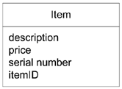
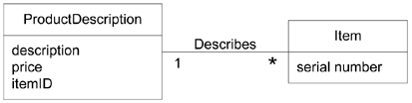
  For example，
worse better

Slide 17
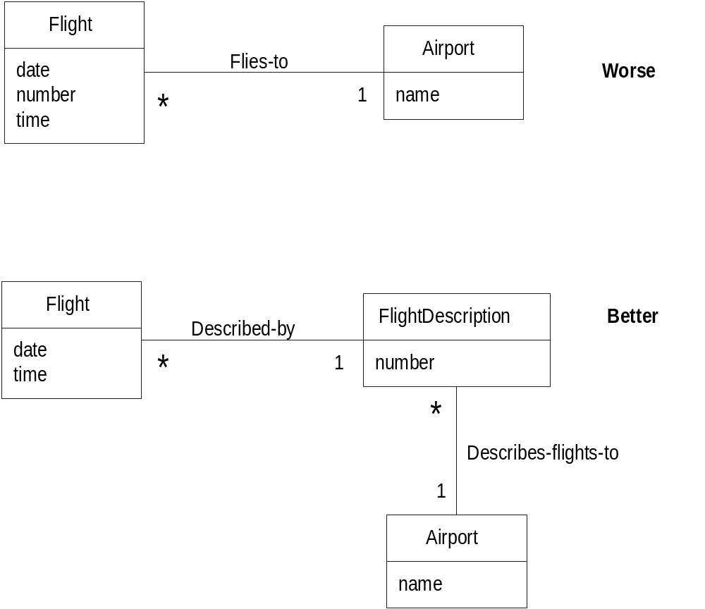
Rules for having Description classes
  If descriptions are independent of the existence of items
  If deleting an object deletes information that may need to be maintained
  If it reduces duplications or adds clarity

Slide 18
Associations (review)
Relationships between classes
  Association has a name, (may with direction)
  Some rules
    A is contained in or on B: “ Board Contains Square.”
    A owns B: “ Players Owns Piece.”
    A is known in/on B: “ Piece Is-on Square.”
    A is member of B: “ Player Member-of (or Plays) MonopolyGame”
  Multiplicity
    How many objects participate
  Role
    Multiplicity
    Names for the roles of the two classes/objects
    Navigability
      How one object will find the other object to send a message
  What is link?
Notes:
Ch 9.15 Each end of an association is called a role

Slide 19
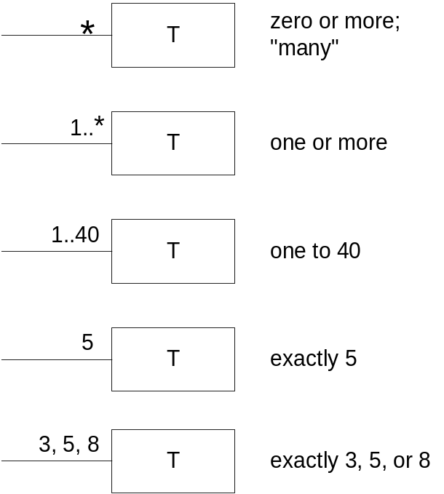
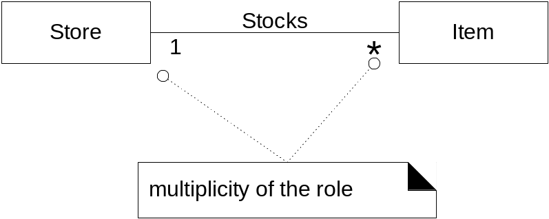
Multiplicity
8

Slide 20
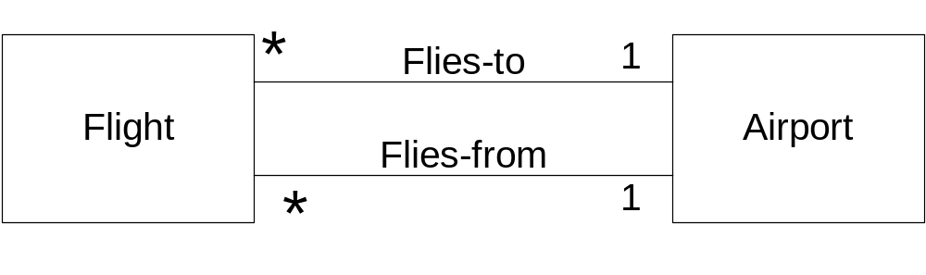
Multiple Associations
Two classes can have multiple relations

Slide 21
Guidelines(ch9.14)
Consider including the following associations in a domain model:
Associations for which knowledge of the relationship needs to be preserverd for some duration(“need-to remember” assocations).
Associations derived from the Common Associations List
Why should we avoid adding many associations?
Focus on “need-to-remember” associations).
How to name an association in UML?
Name an association based on a ClassName-VerbPhrase-ClassName format where the verb phrase creates a sequence that is readable and meaningful.

Slide 22
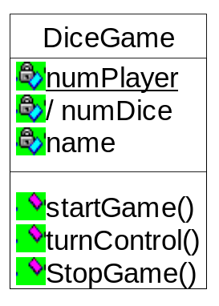
Attributes
An attribute is a logical data value of an object
Guideline: When to Show Attributes?
  need to remember information
  For example,
    Sale needs a dateTime attribute.
    Store needs a name and address.
    Cashier needs an ID.
The difference of these three attributes?
  the attribute name with underline means this attribute has class scope 属性名字下面加了下划线，就表示此属性具有类作用域
  The attribute name with notation’/’ prefix means such attribute is derived attribute 属性名字前面加了‘/’，就表示此属性是导出的（Derived Attributes ）
Notes:
Ch 9.16

Slide 23
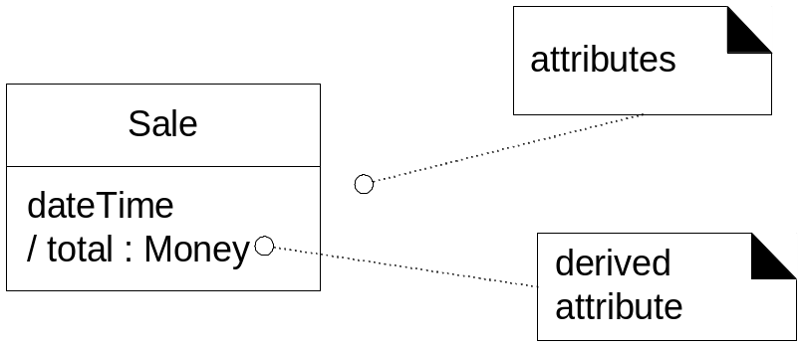
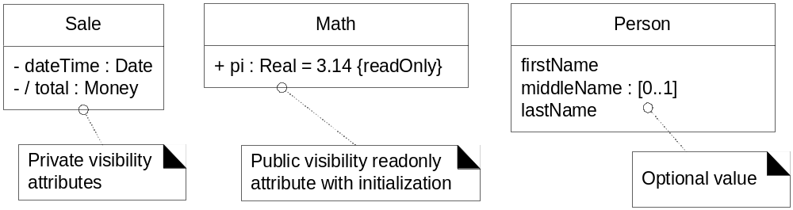
Attributes: notation

Slide 24
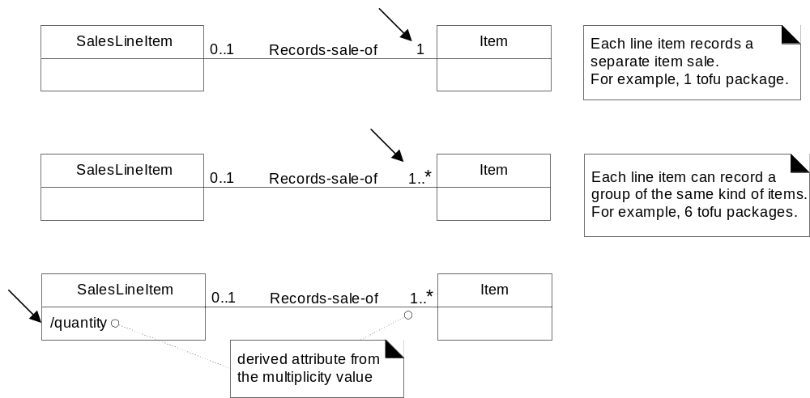
Multiplicity vs. derived attribute

Slide 25

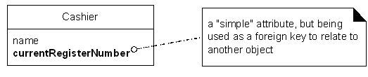
Guidelines
Two tendencies:
Guideline:
Relate conceptual classes with an association, not with an attribute.
Guideline:
No attributes representing foreign keys.

Slide 26
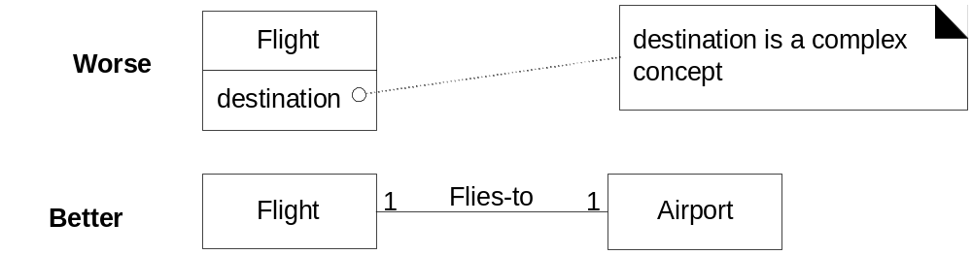
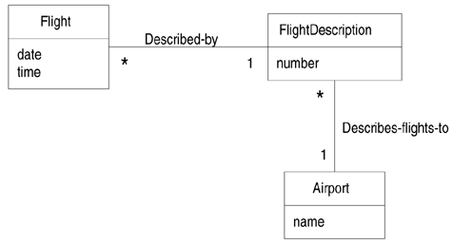
Attributes: examples
Relate with associations, not attributes.
Best

Slide 27
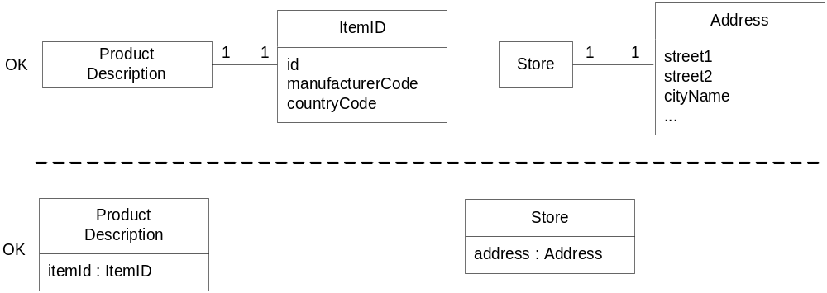
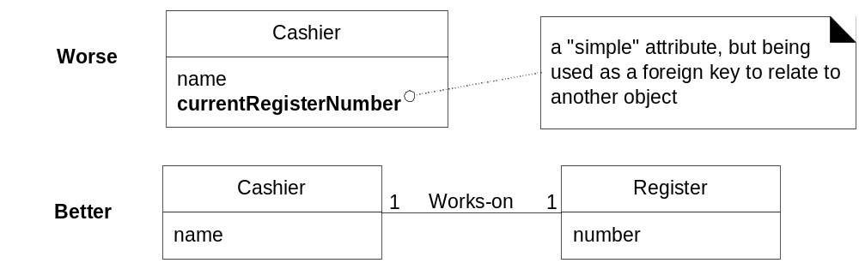
Attributes: examples
Do not use attributes as foreign keys.
Notes:
Domain model: some guidelines, that is all for domain model

Slide 28
Which one is better?
?

Slide 29
作业：
Construct a conceptual model for the hotel reservation system
手绘，请写出过程，可以拍照汇总到一个word文档中提交。
作业提交日期： 10月13日 大夏学堂
Notes:
分析一个“ATM取款机” (自定义需求)

Slide 30
HomeWork
Read / review text book Ch9 ~14
Preparation: Review of OOA
End

